Slide 1


MIS 665 Final Project
Grant Ferrel

Slide 2
Business Understanding
Determine factors that help predict IMDB score by…
Data visualization
Regression analysis
Classification analysis
Clustering Analysis
Storytelling / Conclusion

Slide 3
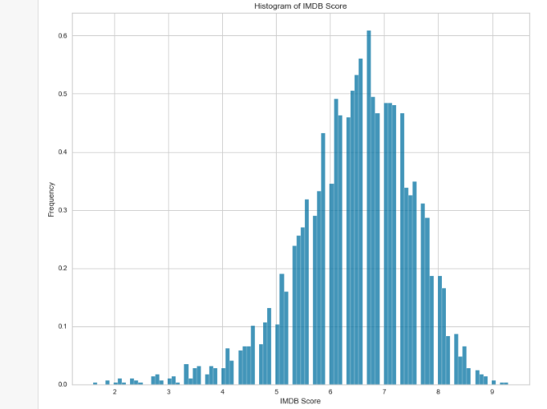
Data Visualization & Business Intelligence
- Movie data has clear normal distribution centered on 7.
- Vast majority of movies score above average
- Target area 8 – 10 IMDB score
- approx. top 25% of movies

Slide 4
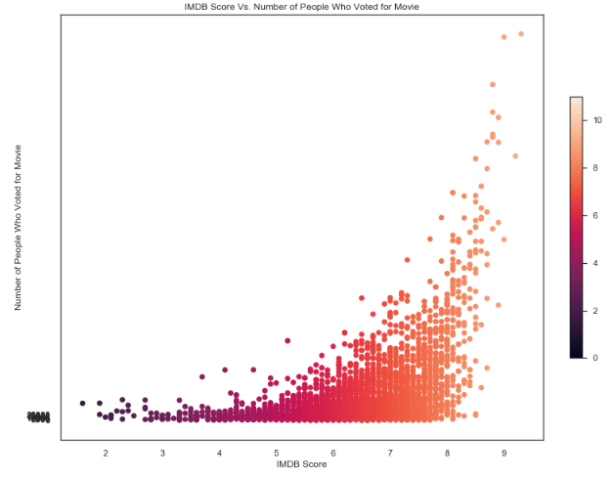
Data Visualization and Business Intelligence
- Clear positive correlation between IMDB score and the number of people who voted.
- more people vote for the good movies
people watch good movies
Strongest correlation we have.

Slide 5
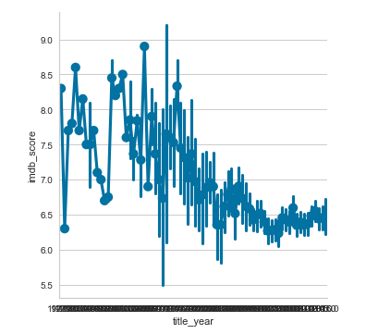
Data Visualization and Business Intelligence
- Overall trend for older movies to be scored higher
- Seems counterintuitive
- Maybe people really enjoy the classics and therefore score them higher?

Slide 6
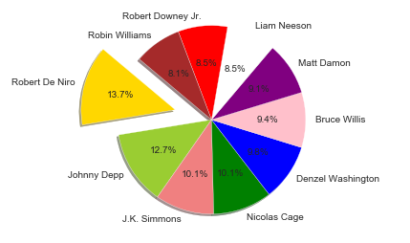
Data Visualization and Business Intelligence
- Top 10 actors_1 values percentage of movies
- Significant proportion of our data set movies list these 10 actors as actor #1.
- All well known famous people.
- Clearly it is important for movies to have a high visibility actor for the main role.

Slide 7
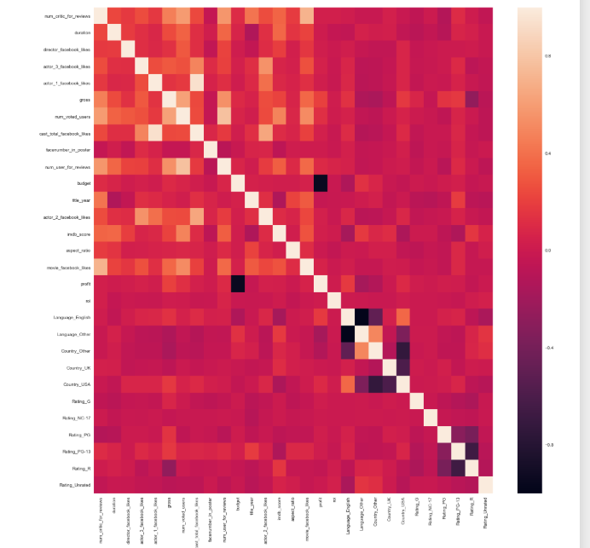
Correlation Analysis
- Most significant predictors
Number of people who voted for the movie (0.482)
Number of critical reviews on imdb (0.348)
Duration in minutes (0.366)
Number of users who gave a review (0.325)
Number of Facebook likes in the movie page (0.281)
Movies whose content rating is R (0.159)
Number of likes on Director on his/her Facebook Page (0.192)

Slide 8
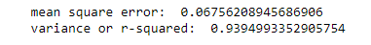
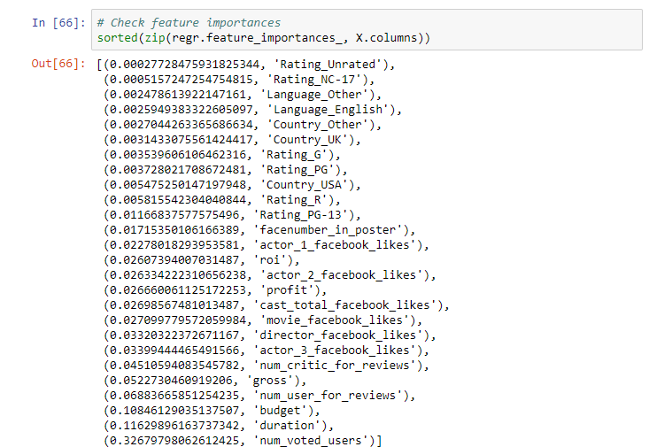
Random Forrest Regression
- Best regression model we were able to produce.

Slide 9
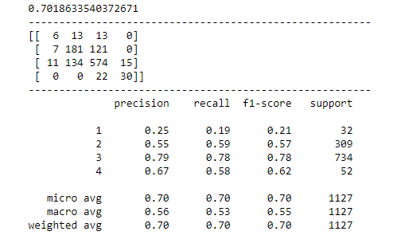
Decision Tree Classification
- Best model we were able to produce in terms of accuracy
- 70.18 % prediction accuracy of our model.

Slide 10
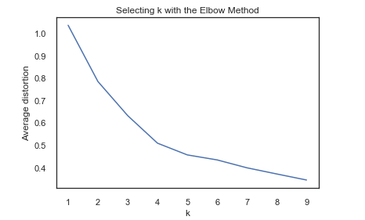
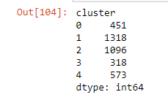
Clustering
- Results did not appear promising for the purpose of helping us identify particular factors for useful in our predictions.
- Cluster plots inconclusive
- Elbow method determined 5 clusters were ideal.

Slide 11
Conclusions
- Important factors identified in correlation analysis and confirmed in regression analysis.
- Utilize identified factors to produce high scoring movies
Possible improvements
- Increase the amount of data collected to help in our clustering
- isolate high scoring and low scoring variables in a single data frame and re-run clustering/classification.

